Slide 1


Tools of the Trade
Dennis and K

Slide 2
DISCLAIMER
Hands-on labs and security presentations are provided for educational purposes only. Attendance at these sessions and the use of this information is not intended to promote unethical and illegal hacking, including cracking, software piracy or any other illegal activity as defined by state and federal laws. The word "hacking" in the context of these training sessions shall only refer to ethical hacking. All information provided in these sessions is for the sole purpose of providing the attendees with the tools to better understand vulnerabilities and in turn help prevent hacking attacks. Information garnered and equipment used during this session must not be used to cause damage by engaging in illegal hacking during or after the session. Any such behavior is a violation of state and federal laws and may subject to prosecution.
Notes:
Just in case.

Slide 3

Software Attacks
Run your network scans
Go for exposed vulnerabilities
Run privilege escalation attacks
Spend a decade looking for the exact data you need
Exfiltrate with as little trace as possible -> Probably get arrested
Spend several decades trying to decode the data
Or…...

Slide 4

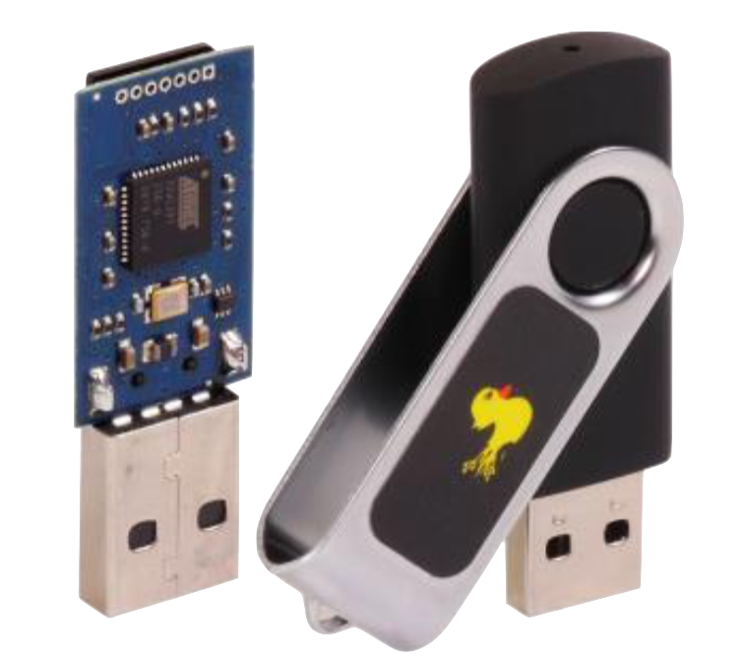
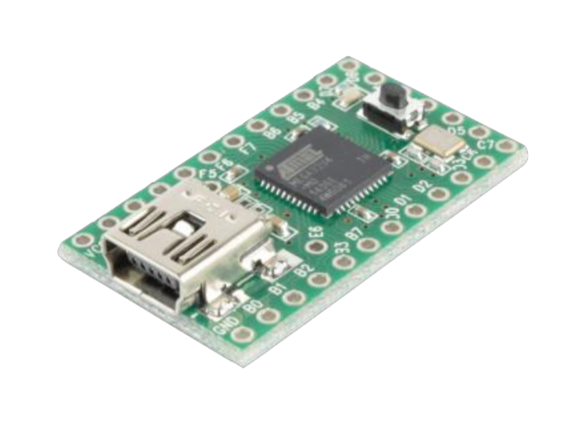

Hardware Attacks
Plug n Play :)
Multiple attack vectors that can be carried out automatically
USB Port
WiFI
Bluetooth

Slide 5
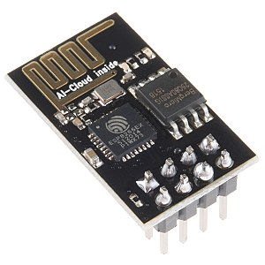
ESP8266
32-bit CPU
Supports the TCP/IP Stack
Allows for spoofing Wi-fi Access Points
Is literally an Arduino BUT
Supports Micro-Python for more scripting capabilities

Slide 6
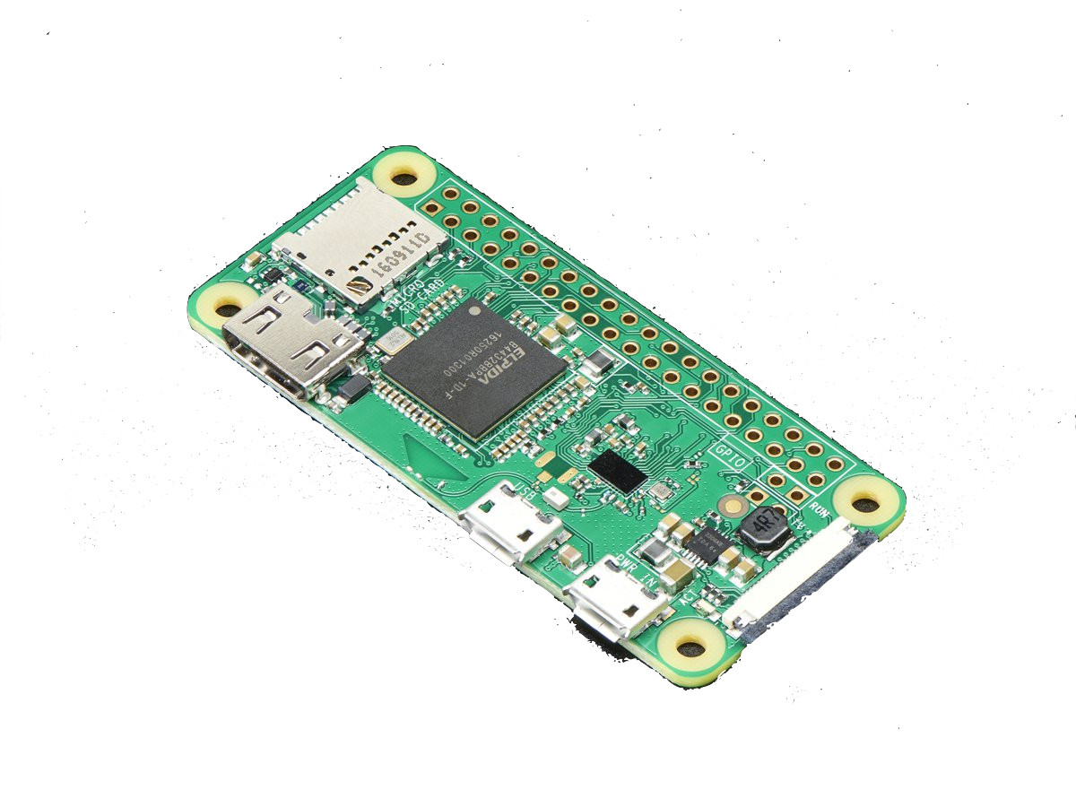
The Raspberry Pi Zero W
1 GHz, Single Core CPU
512mb RAM
802.11 b/g/n Wireless LAN
Bluetooth 4.1

Slide 7
P4wnP1
Developed by MaMe82
https://github.com/mame82/P4wnP1
Turns your raspberry pi zero into a highly customizable usb attack platform
Supports:
Network attacks
Data transfers
HID attacks
And a lot more!

Slide 8
HID-Based Attack:
Goal: Create a plug and play product for Windows/OS X
Automatically launches scripts
Gain a shell on the windows box
Profit

